Slide 1
Fuck Ass planes

Slide 2
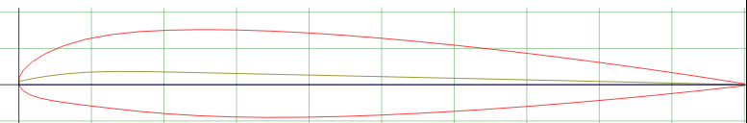
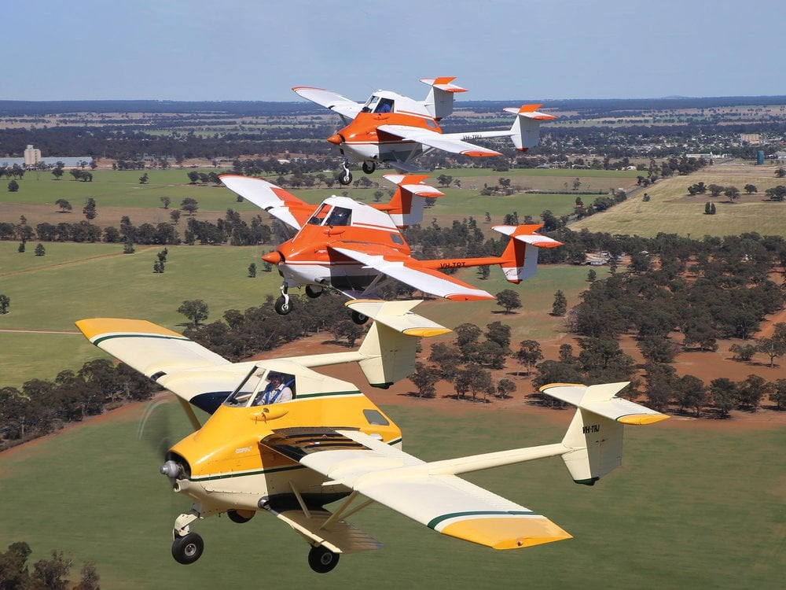
pl-12 Airtruk
Agricultural plane
Lower wing is for chemicals
Fuckass tail is so the metal doesn’t get got by the chemicals
Cant even have a normal airfoil

Slide 3
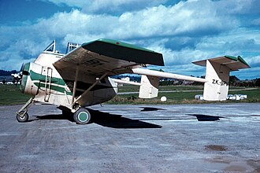
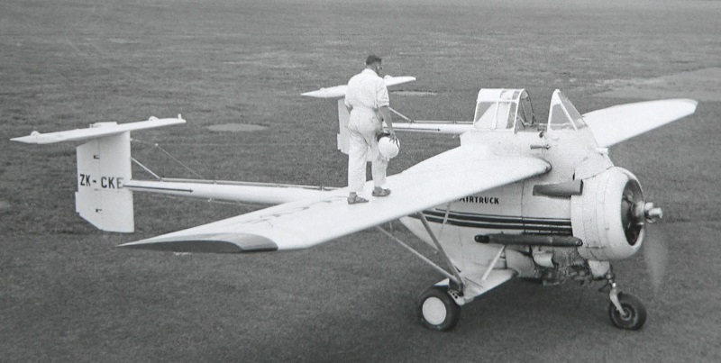
pl-11
Predecessor of the last one
Bro loves the twin tail and super high seat

Slide 4
PL-7
Sounds like kinda more of the same
7 cylinder engine????

Slide 5
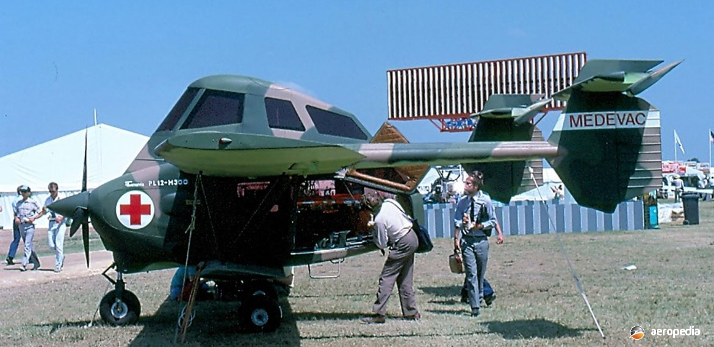
pl-12-MIL
Military variant for the phillipine army
4-6 machine guns to shoot at people in the mountains
Never built

Slide 6
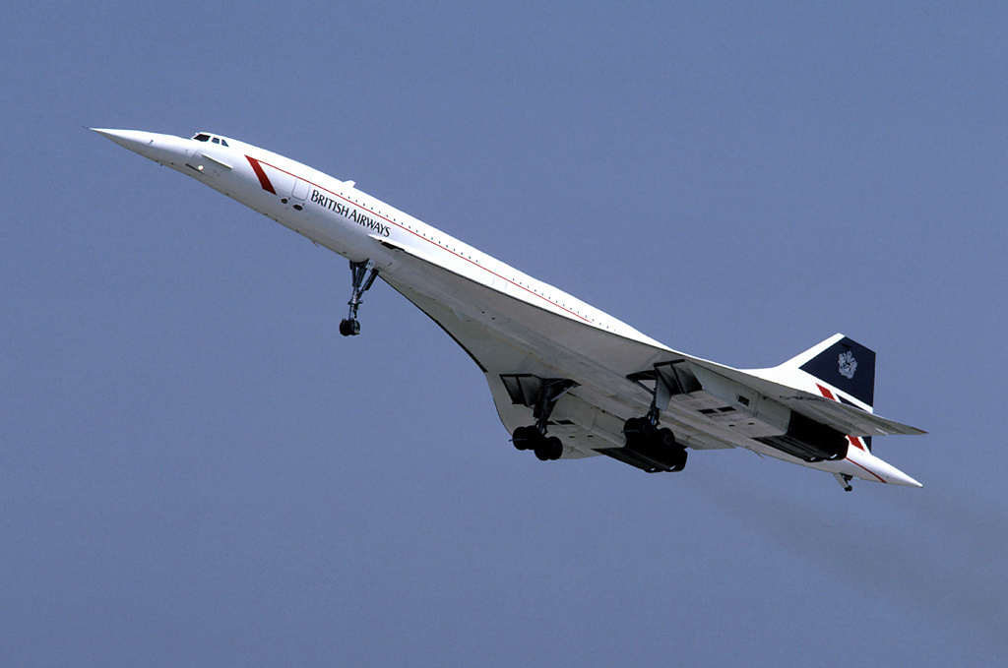
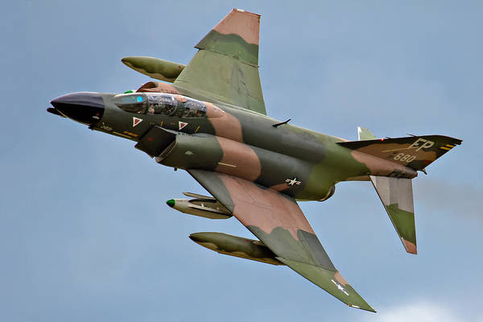
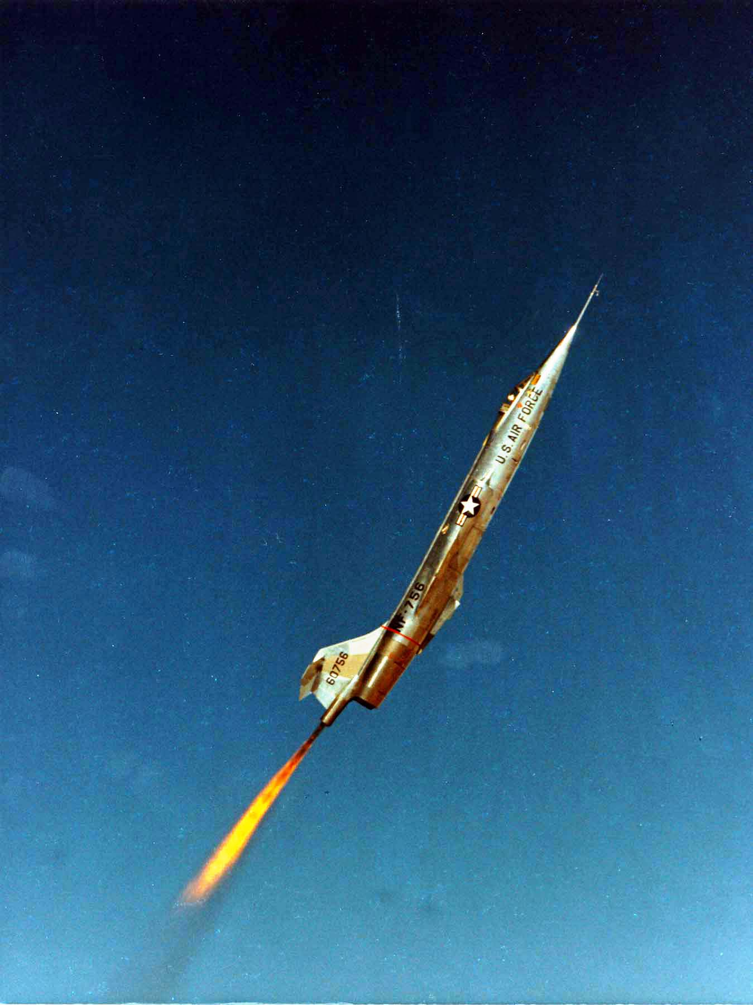
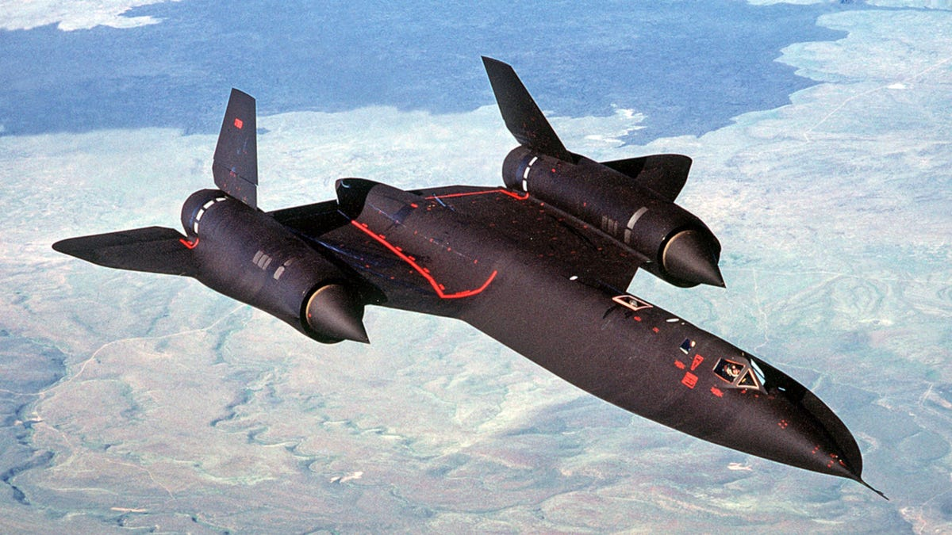
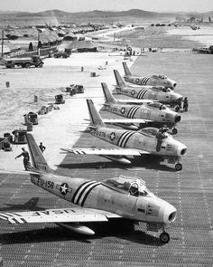
Other 1960’s (war)planes

Slide 7
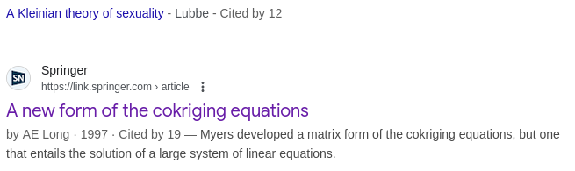
tangent
Looked at the source of a claim on wikipedia
Found paper below

Slide 8

Fuck ass “Planes”
Wings
engine
Landing Gear

Slide 9


HRT racing
Had karun chandhok and daniel riccardo
Raced for 3 years, never placed higher than 13th
No money or so
  it seems

Slide 10
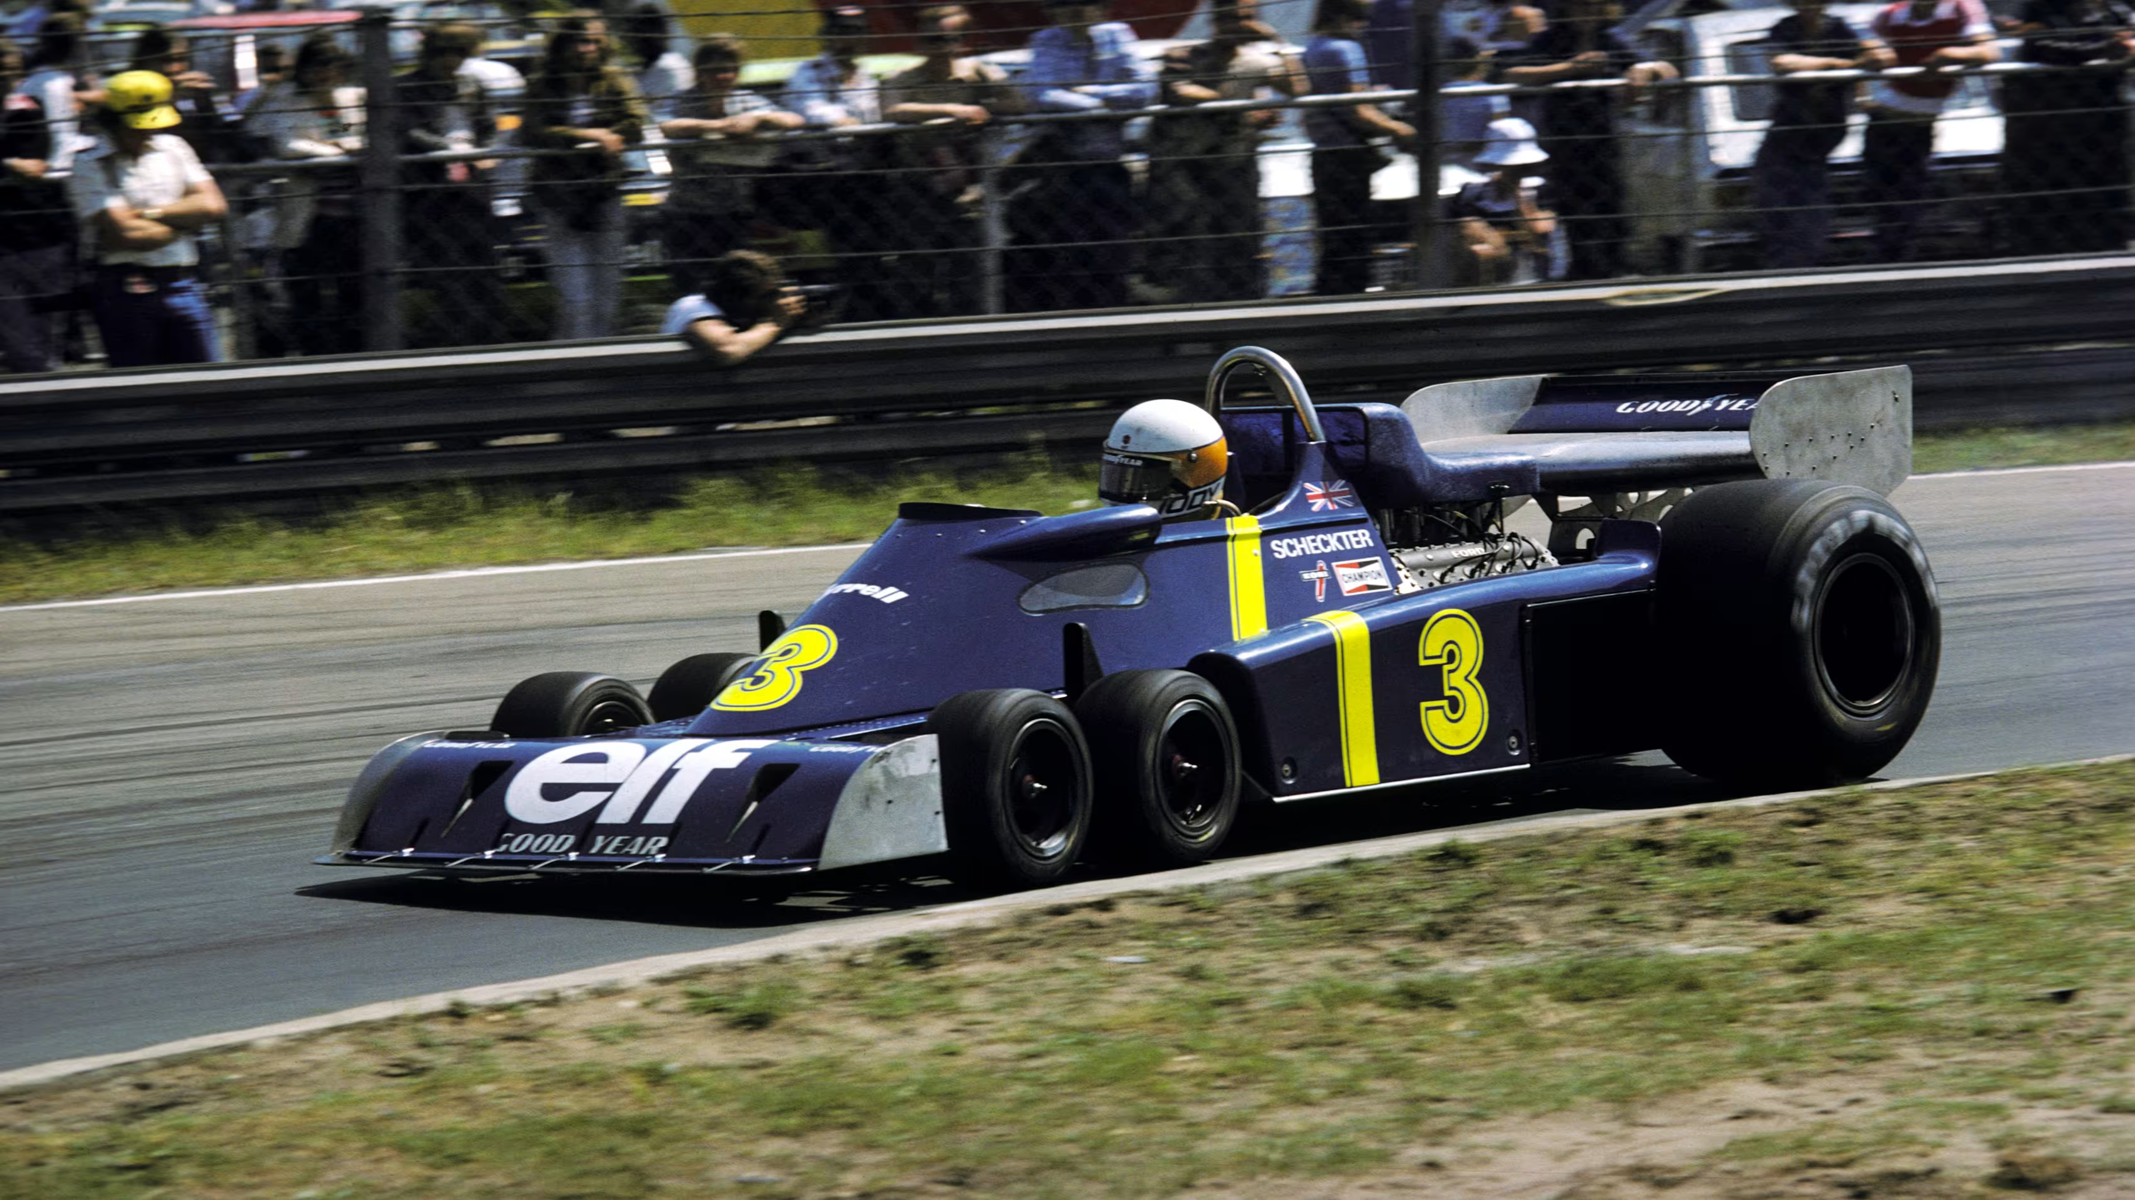
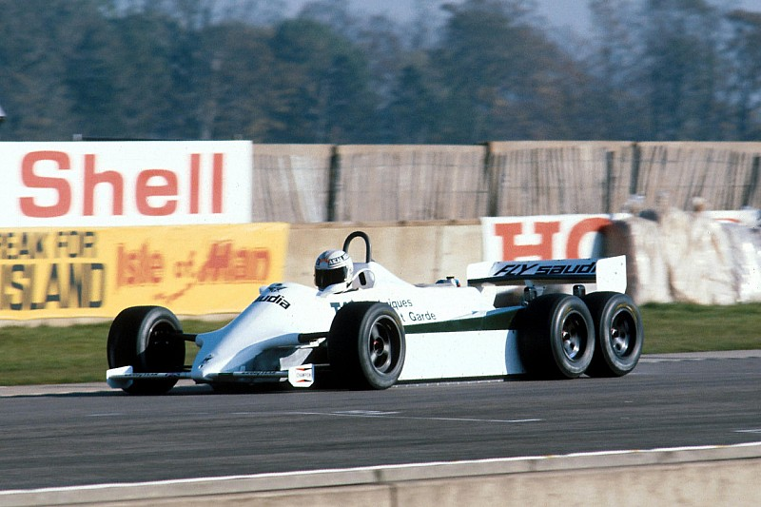
Too many landing gear

Slide 11
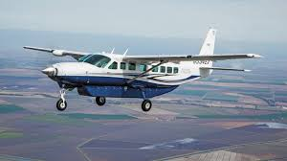
Cessna 208
Pretty normal all in all
I like the cargo hold tbh

Slide 12
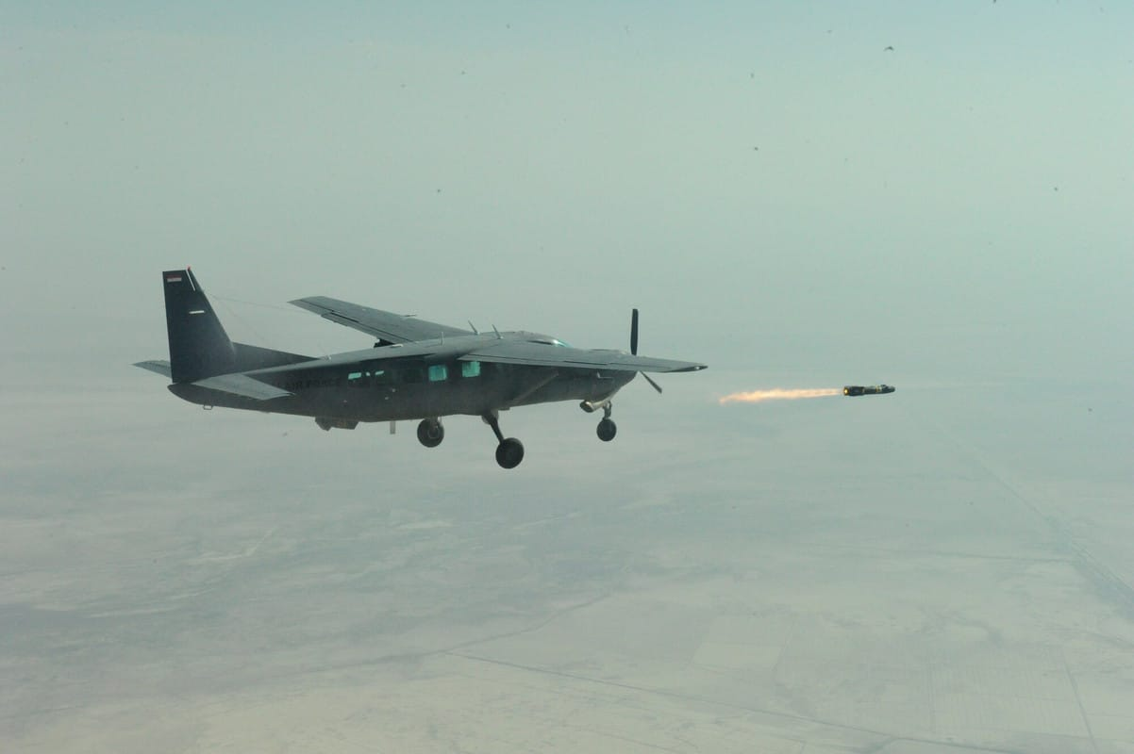
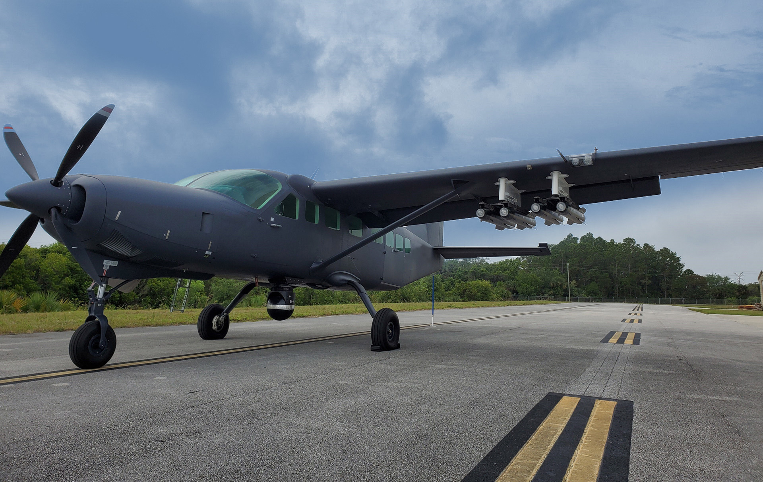
GET OFF THE OZEMPIC
What are the iraqis cooking

Slide 13
End presentation

